Slide 1
Computer Architecture Fall 2024 Lab 3 review
Yuda An

Slide 2
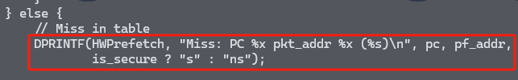
How to debug?
gdb:
Compile the debug build:
scons build/ARM/gem5.debug –j8
Directly use gdb
DPRINTF:
Run with --debug-flags=<flags>
See gem5: Debugging gem5 for details

Slide 3
Lab 3 information
Add cache hierarchy to our system
Read a recent paper about cache prefetcher
Implement the prefetcher in gem5
Due: 12/17

Slide 4
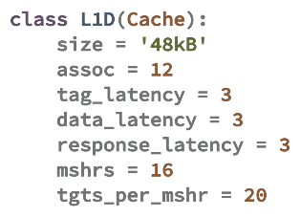

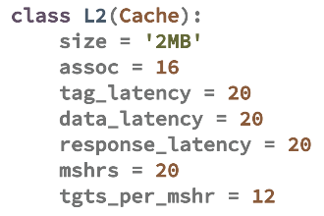
Part 1: Add cache hierarchy
We need to define our own non-abstract cache class

Slide 5
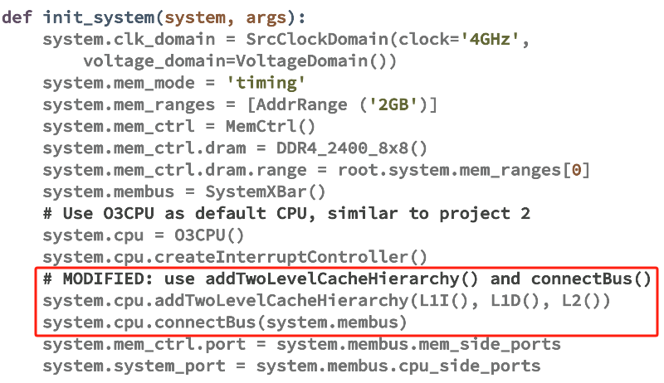
Part 1: Add cache hierarchy
Use helper functions to add cache conveniently

Slide 6
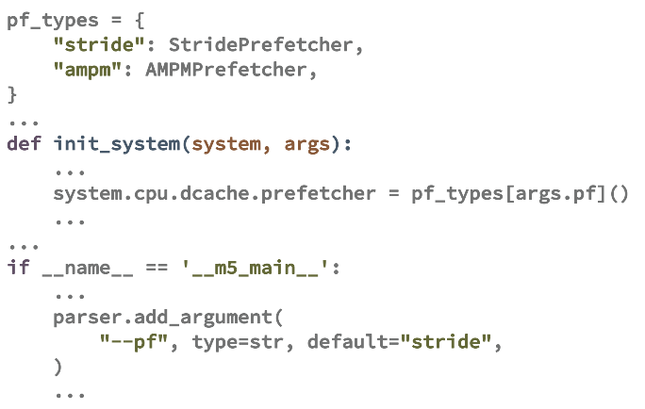
Part 2: Add prefetcher to L1D cache
We compare two pre-defined prefetchers in gem5

Slide 7
Introduction to cache prefetcher
Cache access: hit or miss
High miss penalty → reduce miss rate
Prefetching:
Learn memory access patterns
Fetch data into cache before actual access

Slide 8





Introduction to cache prefetcher
Access pattern: predictable

Slide 9







Introduction to cache prefetcher
Next-line prefetcher: fetch A+1 when access A
Potential miss

Slide 10


Introduction to cache prefetcher
Strided pattern: next-line cannot handle
🥲

Slide 11


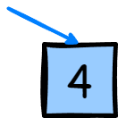
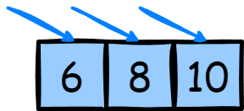
Introduction to cache prefetcher
Stride prefetcher: learn a stride from access history
Stride = +2

Slide 12
Introduction to cache prefetcher
Common metrics to evaluate a prefetcher:
Accuracy: useful prefetches among all issued
Coverage: eliminated cache misses by prefetch among all cache misses
Late: prefetches that are late (data are already accessed when the prefetch is issued)
Degree: prefetch block number on each issue (next-line of next-N-line)

Slide 13
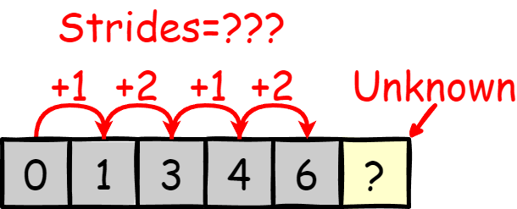
Introduction to cache prefetcher
Delta prefetching: for irregular pattern
Stride: difference between current and last

Slide 14
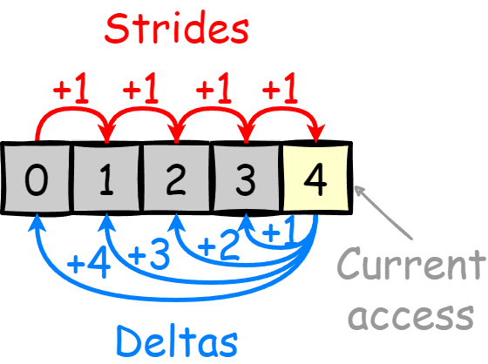
Introduction to cache prefetcher
Delta prefetching: for irregular pattern
Delta: difference between current and all previous

Slide 15
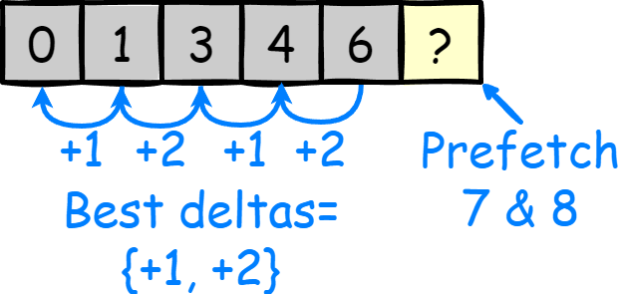
Introduction to cache prefetcher
Delta prefetching: for irregular pattern
Delta: difference between current and all previous

Slide 16
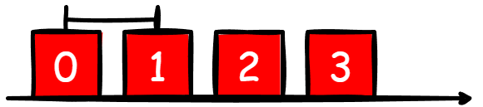



Introduction to cache prefetcher
Timeliness: why prefetches are late?
Access interval is less than fetch latency

Slide 17


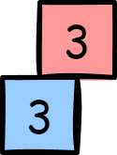
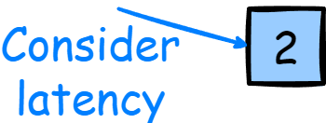

Introduction to cache prefetcher
Timeliness: take latency into consideration

Slide 18
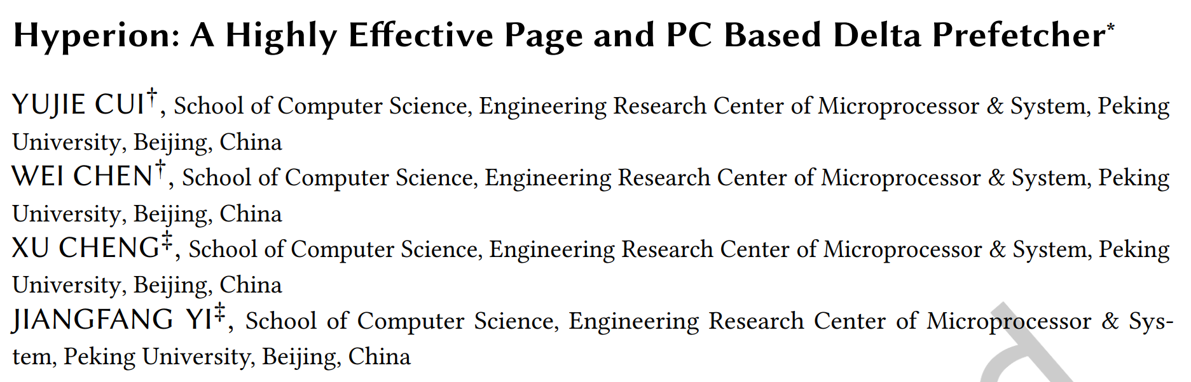
Part 3: Implement cache prefetcher

Slide 19
Part 3: Implement cache prefetcher
Hyperion: timely local-delta based L1D prefetcher
Records access history and timely delta for each individual PC and page

Slide 20
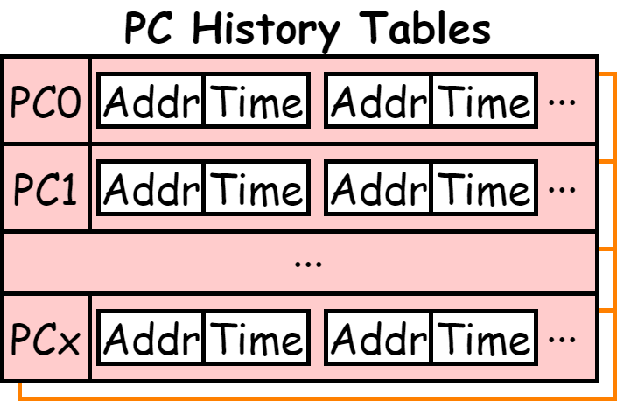
Part 3: Implement cache prefetcher
History: record recent potential misses with their access timestamp

Slide 21
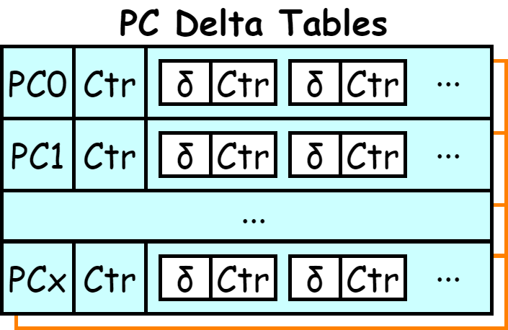
Part 3: Implement cache prefetcher
Delta: record recently occurred timely with their confidence (total counter + local counter)

Slide 22

Part 3: Implement cache prefetcher
Record for PCs and pages

Slide 23
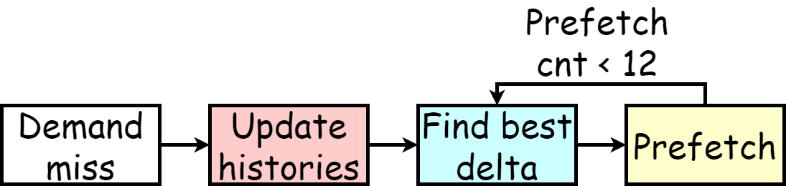
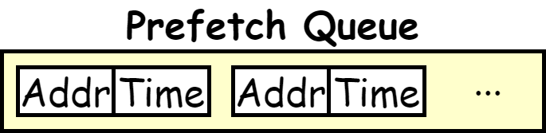
Part 3: Implement cache prefetcher
Working flow

Slide 24

Part 3: Implement cache prefetcher
Working flow

Slide 25
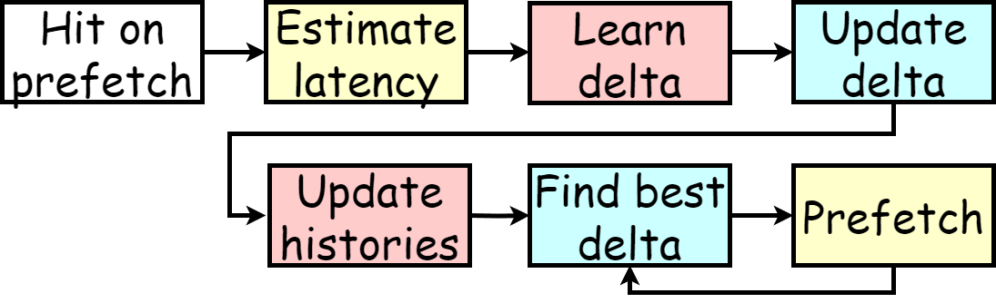
Part 3: Implement cache prefetcher
Working flow

Slide 26
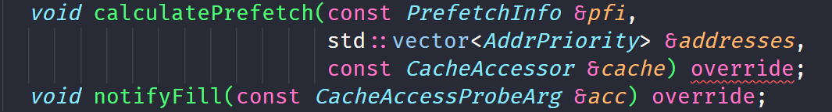
Part 3: Implement cache prefetcher
Interfaces in gem5
calculatePrefetch(): Called when there is a potential miss (demand miss or hit on prefetch)
notifyFill(): Called when data are filled into cache

Slide 27
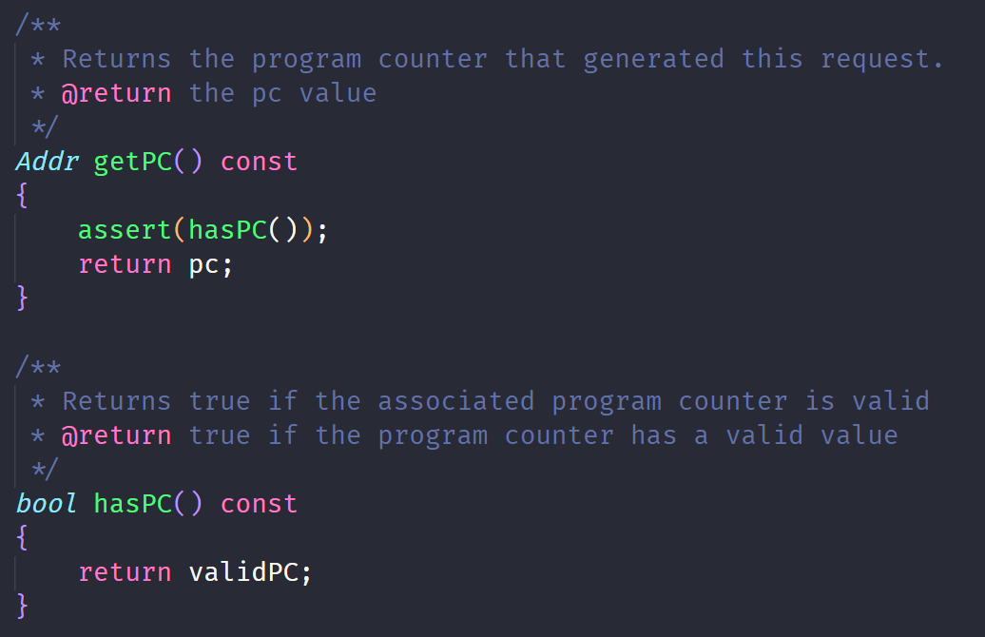
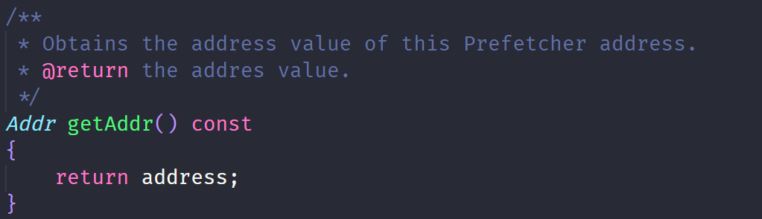
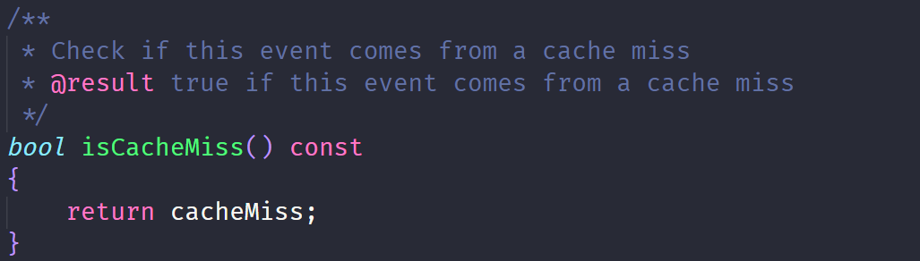
Part 3: Implement cache prefetcher
PrefetchInfo

Slide 28
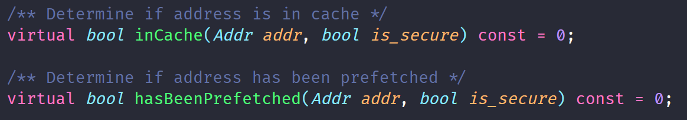
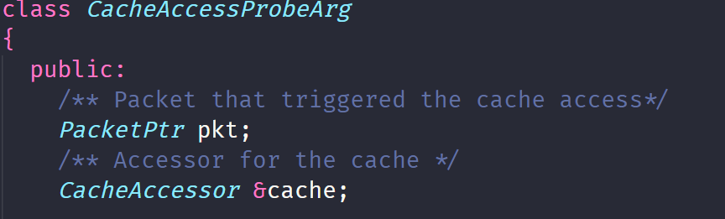
Part 3: Implement cache prefetcher
CacheAccessor
CacheAccessProbeArg

Slide 29
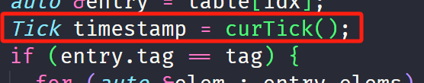
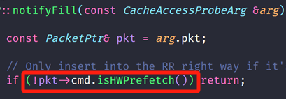
Part 3: Implement cache prefetcher
Timestamp: curTick()
isHWPrefetch() bug?

Slide 30
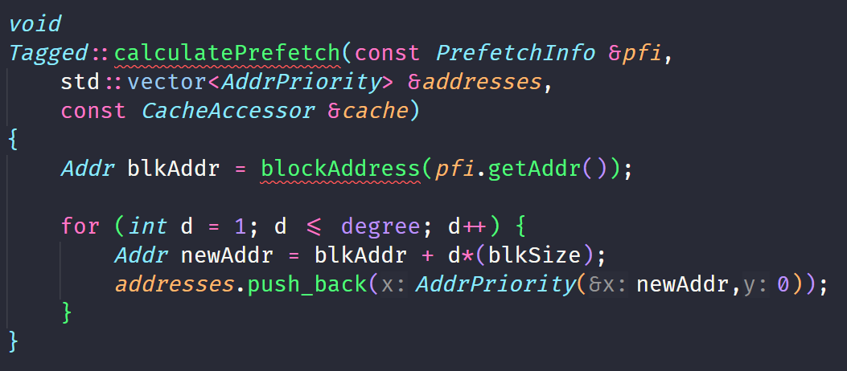
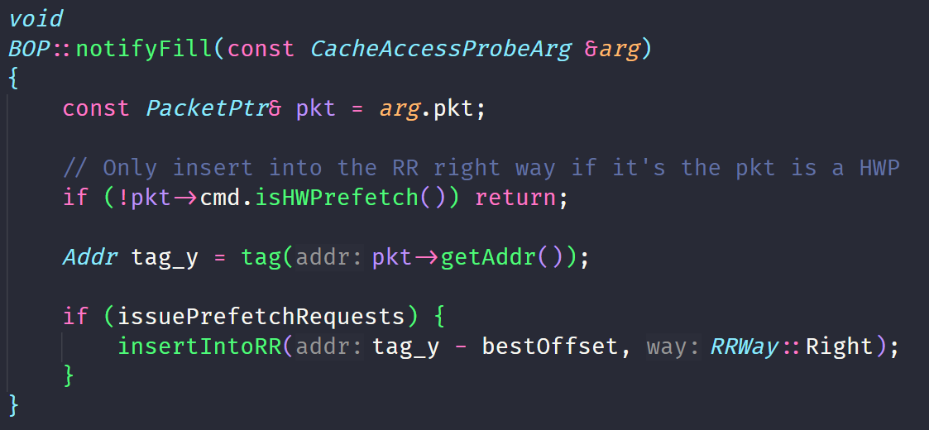
Part 3: Implement cache prefetcher
Examples:

Slide 31
Part 3: Implement cache prefetcher
Tips:
Use block base address everywhere
Record more information (e.g., PC of every access)
Use larger degree (paper uses 1)
Use lower threshold

Slide 32
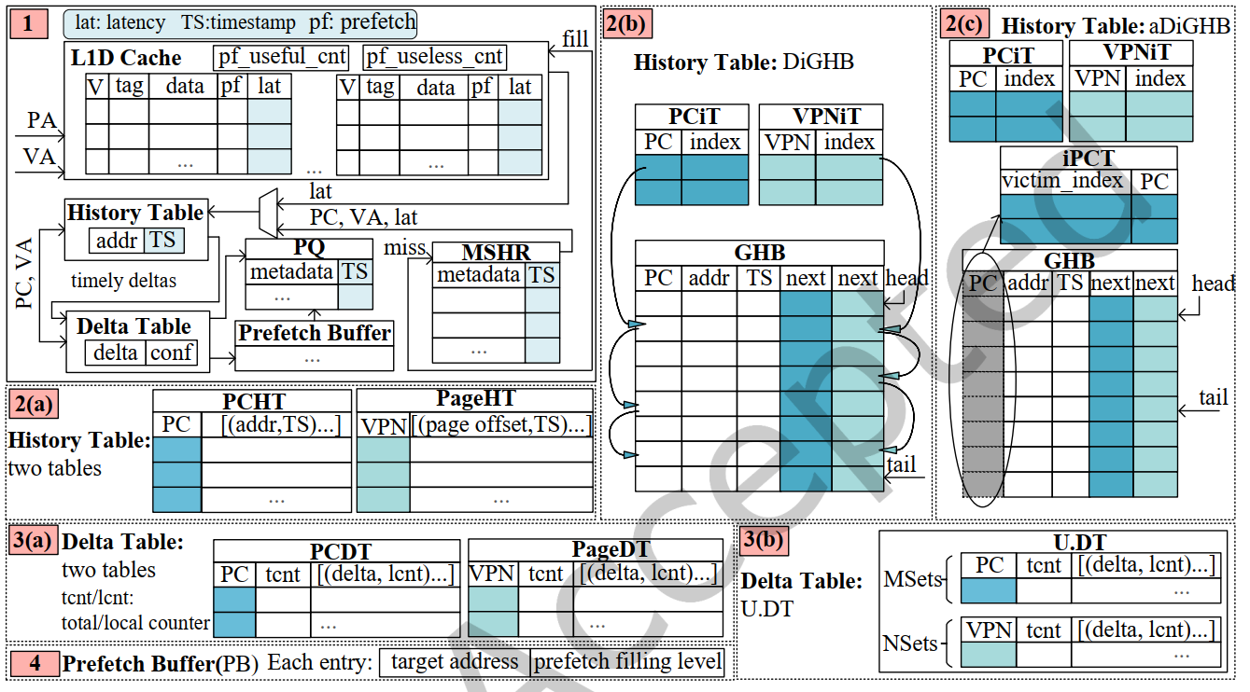
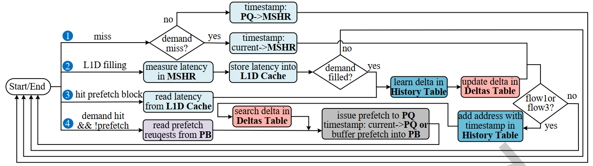
Part 3: Implement cache prefetcher
Features not required:
Lat/TS in cache/MSHR
Unified tables
Prefetch buffer
Cache level selection

Slide 33
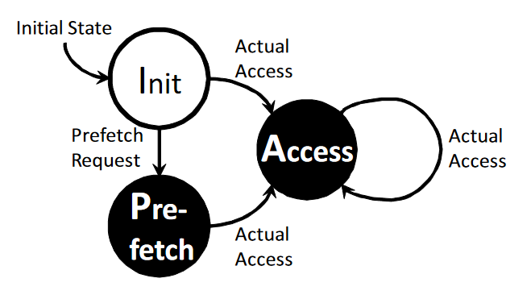
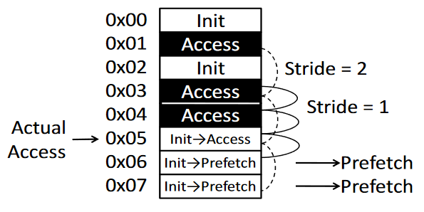
AMPM prefetcher
Calculating useful strides from access history
Ishii, Y., Inaba, M., & Hiraki, K. (2011). Access Map Pattern Matching for High Performance Data Cache Prefetch. J. Instr. Level Parallelism, 13.

